Slide 1


Statistical Analysis of Microsoft, Tesla and Apple Stocks Data
SUBMITTED – Supriya Meshram
SUPERVISED - Smriti Mehta

Slide 2


Contents
Introduction
Microsoft: Descriptive Data
Tesla: Descriptive Data
Apple: Descriptive Data
Percentage Change Statistics: Comparative Data
Stock Price per year Analysis
Comparative Analysis using Histograms
Conclusion

Slide 3
Introduction
The dataset comprises real-time stock data for three prominent technology firms—Microsoft, Tesla, and Apple—gathered from the Yahoo Finance website.
It encompasses daily stock values for these companies spanning the period from 2018 to 2023.
The dataset also incorporates S&P 500 values for the corresponding timeframe. The S&P 500, short for the Standard and Poor's 500, functions as a stock market index that monitors the stock performance of 500 of the largest companies listed on U.S. stock exchanges.
The table includes the percentage change in stock values for each stock, presented as the "%change" variable.

Slide 4

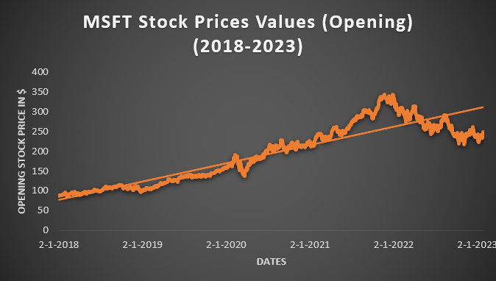
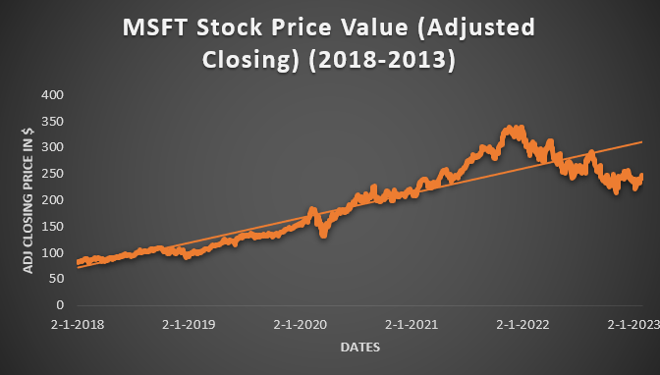
Descriptive statistics for the price of Microsoft stocks from 2018 to 2023
Emerging Pattern: Microsoft stock prices exhibit a consistently increasing trend in both opening and adjusted closing prices from January 2018 to July 2020.
Volatility: Despite the predominant upward trend, there are occasional fluctuations in the data, introducing an element of volatility.
Robust Performance: Microsoft stocks demonstrated impressive performance in 2020, marked by peaks in opening and closing prices. However, there were noticeable downturns, suggesting potential for incurred losses.
Long-Term Investment Potential: Analyzing the five-year data for Microsoft stocks, the trendline indicates a favorable upward trajectory in both opening and adjusted closing prices, suggesting that they present a promising option for long-term investment.

Slide 5
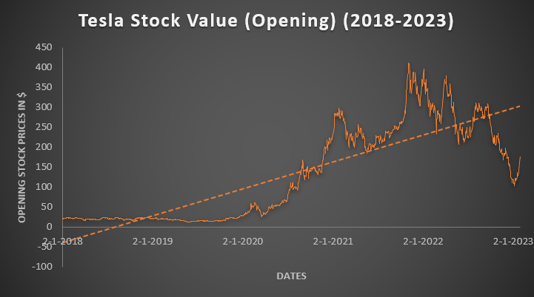
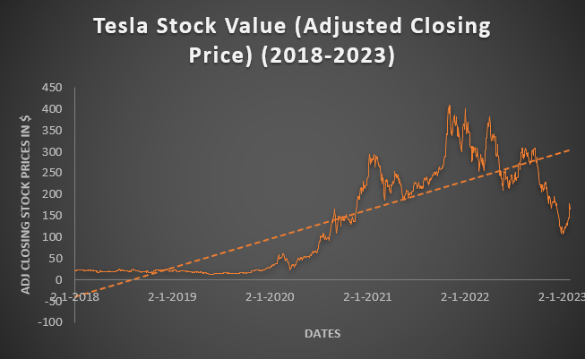
Descriptive statistics for the price of Tesla stocks from 2018 to 2023
Patterns: Over the course of five years, Tesla's stock market prices exhibit notable instability, characterized by frequent peaks and troughs. The values experience sharp upward surges and corresponding declines.
Initial Stability: At the commencement of the analyzed period, both opening and adjusted closing prices for Tesla stocks maintained a consistent straight line, starting at remarkably low values, as minimal as $12. This persisted until 2020, when a noticeable upward shift occurred.
Remarkable Surge in 2022: The year 2022 witnessed a substantial increase in Tesla's stock value, reaching a peak of approximately $411.
Volatility Warning: Despite the pronounced volatility in Tesla stocks, signifying a considerable risk for long-term investments, the graph depicts an upward trend in price values. While this trend can be advantageous for those seeking gains, it is essential to bear in mind that the stocks may experience dips, but they also have the potential to rebound.

Slide 6
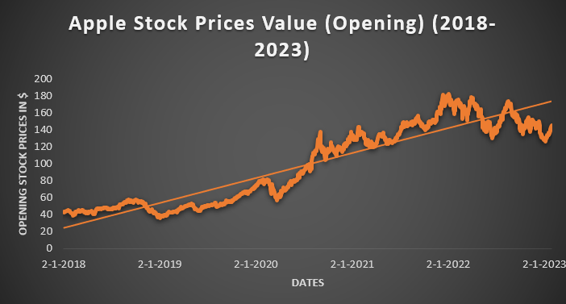
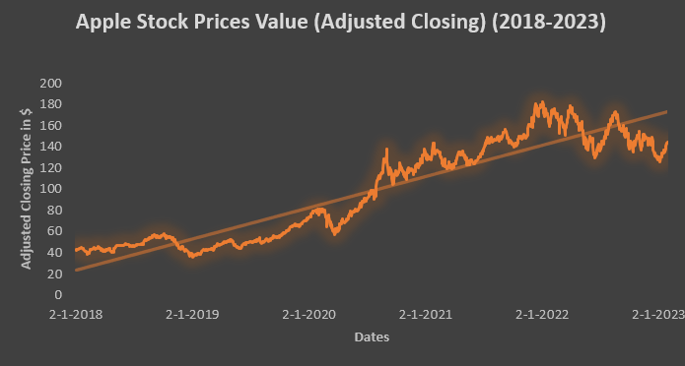
Descriptive statistics for the price of Apple stocks from 2018 to 2023
Fluctuation Overview: The Apple trend chart displays considerable fluctuation, with prices experiencing notable ups and downs. The graph illustrates the potential for drastic changes within a span of months.
Short-Term Volatility: On a day-to-day basis, fluctuations are observed, posing a risk for those engaging in daily stock purchases. This short-term volatility could lead to losses if the stock value falls the next day.
Peak Value: Despite short-term fluctuations, the graph indicates stability. Notably, the stocks followed an upward trajectory from 2020, almost reaching a peak at $182 in April 2022.
Long-Term Investment Potential: Examining the overall trajectory of Apple stock prices, encompassing both opening and adjusted close values, reveals a consistent upward trend, especially from 2020 to mid-2022. Despite short-term volatility, the trend analysis suggests that Apple stocks have the potential to contribute to future growth and offer value for long-term investments.

Slide 7
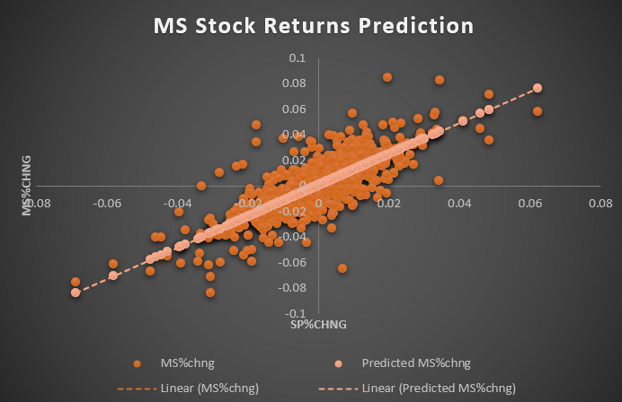
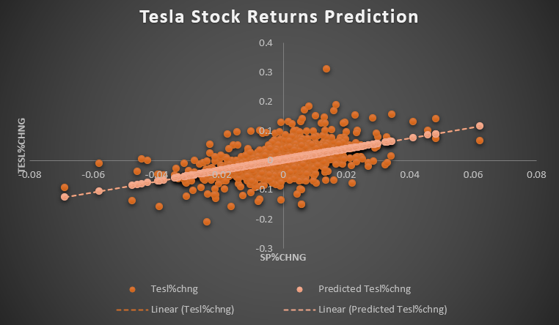
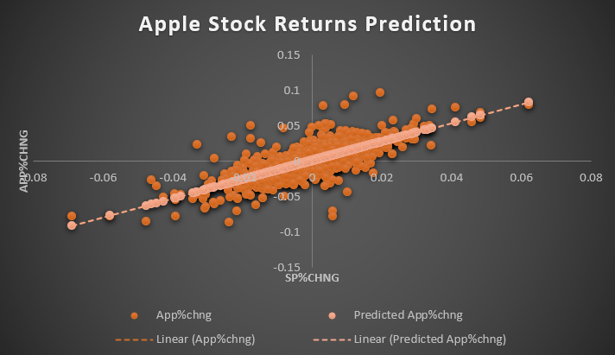
Comparative Analysis of Stock Market Data
Microsoft Returns Prediction
Tesla Returns Prediction
Apple Returns Prediction

Slide 8
In accordance with the Capital Asset Pricing Model (CAPM), the beta slope coefficient in a basic regression of stock excess returns serves as an indicator of relative risk. It gauges how responsive a stock is to changes in the overall market, represented by the S&P index. Stocks with higher beta values are perceived as riskier and often yield higher returns in the market.
Microsoft Scatter Plot
Correlation with market trends is evident.
Simple regression shows Microsoft aligning closely with the trendline, with few variables scattered at a distance.
Some investors may base stock purchases on factors beyond the overall market trend.
The scatter plot suggests that Microsoft investors may be influenced by broader market conditions.
Tesla Scatter Plot:
Significant variation observed, scattered widely from the market trendline.
Indicates that Tesla investors might make independent investment decisions, influenced by company-specific news, rather than closely following the broader market trend.
Apple Scatter Plot:
Minimal variation observed, closely aligning with the trendline based on the S&P 500 index.
Suggests that Apple investors tend to follow market trends, adjusting their positions accordingly with market movements.

Slide 9
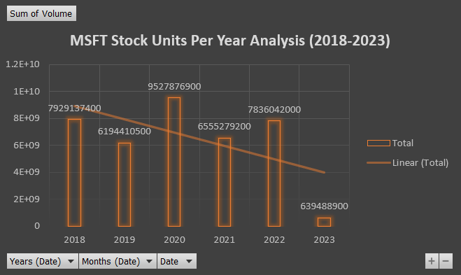
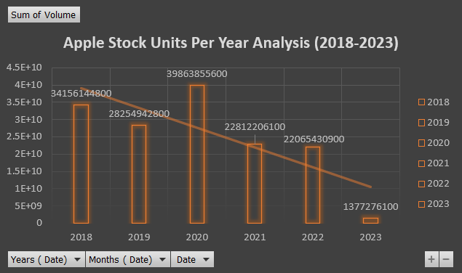
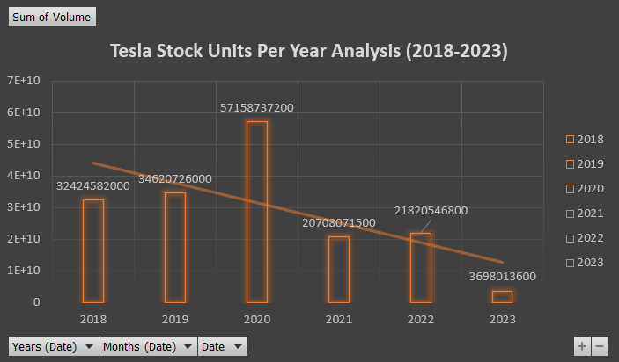
Stocks Per Year Analysis
Stock Units Analysis for all three companies reflects the volume of stocks within each company.
Significant growth was observed in the stocks of Microsoft, Apple, and Tesla during the year 2020, reaching their peak. However, the stock volume was at its lowest in 2023.
Examining the 5-year trendline in stock volume reveals a downward trajectory. This decline has been consistent since the significant peak observed in 2020.

Slide 10

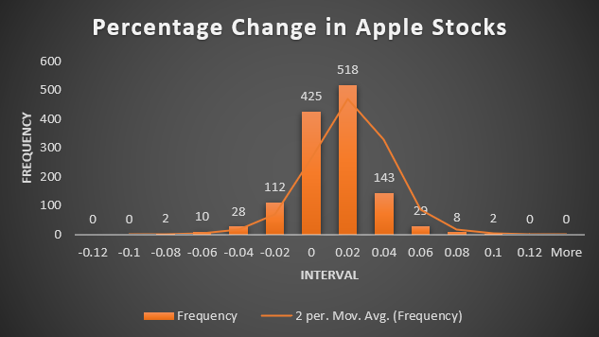
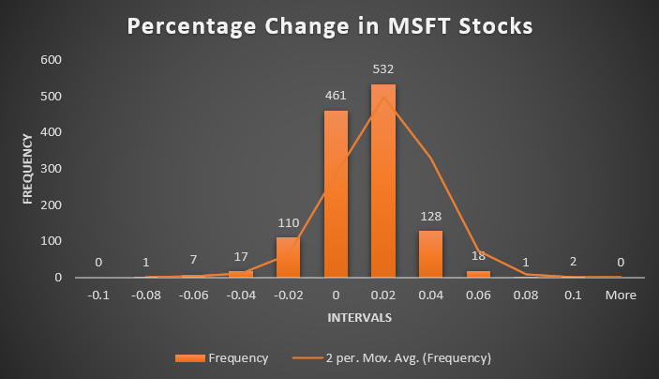
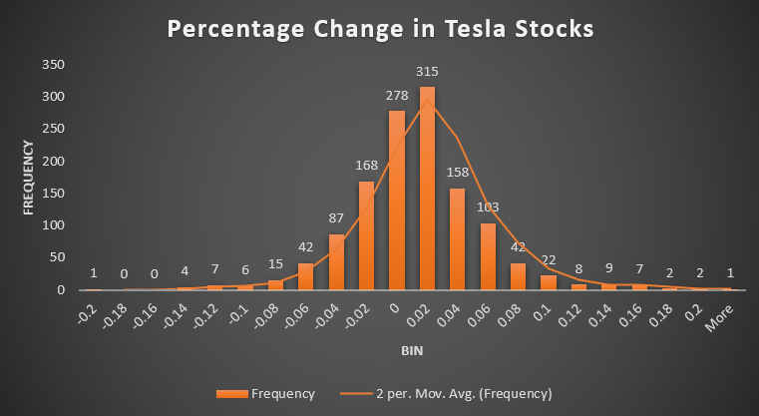
Comparative Analysis using Histograms
The charts illustrate the returns on company stocks, measured at equal intervals.
It is noticeable that among them, Apple stocks exhibit the most stability, indicated by the smallest standard deviation, while Tesla stocks display the highest deviation.

Slide 11
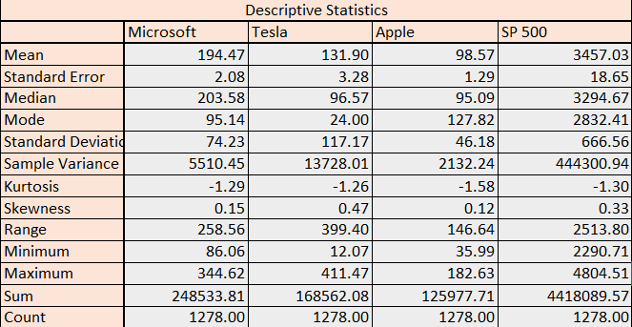
Descriptive Statistics
The mean (average) stock prices for the three companies are as follows: Microsoft (MSFT) at $194.47, Tesla at $131.90, and Apple at $98.57.
When examining the median (middle) prices, variations are observed, indicating potential skewness or outliers: MSFT at $203.58, Tesla at $96.57, and Apple at $95.09.
Notably, the standard deviation is relatively high for Tesla ($117.17) and Microsoft ($74.23), suggesting higher price variability compared to Apple ($46.18).
The range of prices also displays significant variation, with Tesla having the widest range (399.40) and Apple having the narrowest (146.64).
Kurtosis values for all datasets are less than 3, implying relatively platykurtic (less peaked) distributions compared to a normal distribution.
Skewness values are close to 0, suggesting that the data is approximately symmetric, although Tesla shows a slight positive skew.
The highest observed stock price is for Tesla ($411.47), followed by Apple ($182.63), Microsoft ($344.62), and the S&P 500.
The lowest stock price observed is for Apple ($35.99), followed by Microsoft ($86.06), Tesla ($12.07), and the S&P 500.

Slide 12
Conclusion
When comparing Microsoft, Apple, and Tesla stocks, it appears that Tesla carries a higher level of risk compared to the other two.
Despite all three major companies enjoying a favorable profit margin in the stock market and exhibiting stable growth, some display less deviation in stock prices.
The analysis provides investors and traders with a clear understanding of the considerations for both long-term and short-term investments based on market conditions over time.

Slide 13
Thank You

